Slide 1



KONGUNADU COLLEGE OF ENGINEERING AND TECHNOLOGY
(AUTONOMOUS)
Tholurpatti (P.O), Thottiam –T.K, Trichy – 621 215.
Department of Electronics and Communication Engineering
HX8001 - PROFESSIONAL READINESS FOR INNOVATION, EMPLOYABILITY AND ENTREPRENEURSHIP
PROJECT TITLE
Domain of the Project : IOT
Batch ID : B12-6A2E
Team ID : PNT2022TMID13531
Academic Year : 2022-2023
Year/Semester : IV/VII
Team Members:
P.MENAGHA (621319106055)
P.NISHA (621319106062)
P.RAMYA (621319106074)
R.RUKMANI (621319106313)
Mentor:
Mrs.T.Meenal ASP/ECE

Slide 2

Table of Contents
S.No. | Content | Slide No.
1 | Objectives
2 | Abstract
3 | Introduction
4 | Literature Survey
5 | Problem Identification
6 | Block Diagram
7 | References

Slide 3
Objectives
Through this project a farmer can monitor the temperature, humidity and soil moisture parameters along with weather forecasting details.
It reduce the extravagant use of resources such as Water and Electricity.
And also the sensors and interconnectivity, the Internet of Things in Agriculture has save the time of the farmers.
1

Slide 4
Abstract
IOT based Smart Farming improves the entire Agriculture system by monitoring the field in real-time. With the help of sensors and interconnectivity, the Internet of Things in Agriculture has not only saved the time of the farmers but has also reduced the extravagant use of resources such as Water and Electricity.
So in this project a farmer can monitor the temperature, humidity and soil moisture parameters along with weather forecasting details. Based on these details he can water the crops by controlling the motors through the app.
2

Slide 5
Introduction
Agriculture plays a crucial role in the life of an economy. It is the backbone of our economic system, so improving the quality and way of production is crucial. Here comes the Smart Agriculture system.
Smart agriculture helps in automated farming, collection of data from the field and then analyses it so that the farmer can make accurate decision in order to grow high quality crop.
3

Slide 6
Literature Survey
TITLE | AUTHOR & YEAR | JOURNAL NAME | REMARKS
Smart Farming System using IOT | Venkatarao Dadi & 2020 |  | The propose of this Smart IOT based Agriculture assisting farmers in getting Live Data(Temperature, Soil Moisture) for efficient environment monitoring which will enable them to do smart farming and increase their overall yield and quality of products. LIMITATIONS: Lack of interoperability which is necessary when we use about large agricultural fields.
4

Slide 7
Literature Survey
TITLE | AUTHOR & YEAR | JOURNAL NAME | REMARKS
Internet of Things in Smart Agriculture | Navod Neranjan Thilakarathne & 2021 |  | These systems enable to check the quality of the soil and the growth of the crop in soil and with these system farmers are able to solve irrigation problems, temperature problems, humidity problems, etc. So, farmers are able to control various equipment’s related to agricultural and monitor their crop on Smartphone or on computers. LIMITATIONS: Security and privacy. Knowledge and attitude towards adoption of technology
5

Slide 8
Literature Survey
TITLE | AUTHOR & YEAR | JOURNAL NAME | REMARKS
Internet-of-Things (IOT)-Based Smart Agriculture | Muhammad Ayaz ,Mohammad Ammad-Uddin & 2019 |  | The growth of the global population coupled with a decline in natural resources, increase in unpredictable environmental conditions leads to food security is becoming a major concern for all nations worldwide. These problems are motivators that are driving the agricultural industry to transition to smart agriculture with the application of the Internet of Things (IOT) and big data solutions to improve operational efficiency and productivity. LIMITATIONS: Economic Efficiency Technical Problems
6

Slide 9
Literature Survey
TITLE | AUTHOR & YEAR | JOURNAL NAME | REMARKS
Internet of things for smart agriculture: Technologies, practices and future direction | Partha Pratim Ray & 2019 |  | A dynamic global network infrastructure with self-configuring capabilities based on standard and interoperable communication protocols where physical and virtual things have identities, physical attributes, and virtual personalities and use intelligent interfaces, and are seamlessly integrated into the information network. LIMITATIONS: Autonomy User control panel Interoperability
7

Slide 10
Literature Survey
TITLE | AUTHOR & YEAR | JOURNAL NAME | REMARKS
A Study on the roles of IOT in the agriculture for smart farming Implementation. | Ashok Kumar & 2021 |  | The integration of the IOT based farming production with crucial technologies like clouds computing, vast data storages, or analytic was also explored. In additions, issue about security in the IOT farming have been highlights. A collection of the smart phones or sensor-based apps for many aspects of farm management is also available. LIMITATION: Hardware Issues Networking Obstacles
8

Slide 11
Literature Survey
TITLE | AUTHOR & YEAR | JOURNAL NAME | REMARKS
Smart Agriculture Monitoring and Control System Using IOT | Zuraida Muhammad & |  | For better crop growth moisture, mineral, light and other factors can be assumed. This research looks into a few of these characteristics for data analysis with the goal of assisting users in making better agricultural decisions using IOT. The technique is intended to help farmers increase their agricultural output. LIMITATIONS: The water consumption will be higher or that the time it takes for the water to reach the destination will be longer.
9

Slide 12
Problem Identification
Agriculture is extremely dependent on the climate.
Severe weather other than heat and cold can cause loss and devastation to a farm. Most farmers can’t avoid the results of extreme weather.
Diverse extreme weather can affect farms in different ways. Because of this, it’s important that farmers have a proper system and need a mobile application to monitor the weather changes and to control the motor.
10

Slide 13
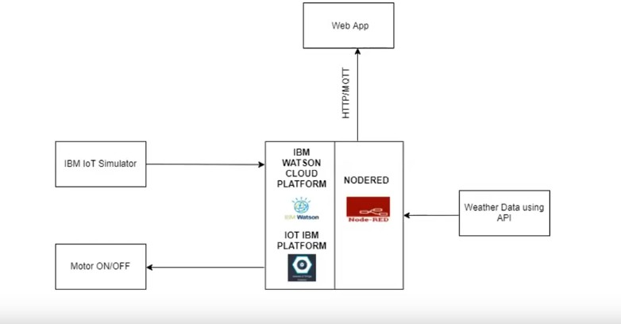
Block Diagram
11

Slide 14
References
Zuraida Muhammad,Muhammad Azri Asyraf Mohd Hafez,Nor Adni Mat”Smart Agriculture Using Internet of Things with Raspberry Pi.” 2020.
Divya J., Divya M.,Janani V.”IoT based Smart Soil Monitoring System for Agricultural Production” 2017.
H.G.C.R.Laksiri, H.A.C.Dharmagunawardhana, J.V.Wijayakulasooriya ”Design and Optimization of loT Based Smart Irrigation System in Sri Lanka”2019.
Anushree Math, Layak Ali, Pruthviraj U ”Development of Smart Drip Irriga- tion System Using IoT”2018.
Shrihari M, ”A Smart Wireless System to Automate Production of Crops and Stop Intrusion Using Deep Learning” 2020.
G. Sushanth1, and S. Sujatha, ”IOT Based Smart Agriculture System”2018.
12

Slide 15
References
7. Dweepayan Mishra1 ,Arzeena Khan2 Rajeev Tiwari3 , Shuchi Upadhay,”Automated Irrigation System-IoT Based Approach”,2018.
14

Slide 16
Questions & Discussion

Slide 17
THANK YOU

